Slide 1


Brute Force, and When It Is the Right Answer
07
PART II · RECURSION AND DIVIDE-AND-CONQUER
CHAPTER 7 · WEEK 5
Design, Proof and Measurement
LECTURER
Dr. Mustafa Hameed
THE ISLAMIA UNIVERSITY OF BAHAWALPUR
Bahawalpur, Pakistan
Department of Information Technology · BSIT · Fall 2026
Notes:
Chapter 7: Brute Force, and When It Is the Right Answer. Part 2 — Recursion and Divide-and-Conquer. Week 5: Brute force; divide and conquer. Handout pages 56–63.

Slide 2

Where this chapter sits
THE COURSE
PART I
PART II
PART III
PART IV
PART V
PART VI
1
2
3
4
5
6
7
8
9
10
11
12
13
14
15
16
17
18
19
20
21
22
23
Brute Force, and When It Is the Right Answer
BUILDS ON
USED LATER IN
Ch 3 Asymptotic Notation
Ch 14 Greedy Algorithms
Ch 4 Correctness: Loop Invariants
Ch 16 Dynamic Programming II: Classic Problems
Ch 21 String Matching
Ch 23 The Semester Project
Analysis of Algorithms · Chapter 7 · Brute Force, and When It Is the Right Answer
Handout p. 56 2
Notes:
Place the chapter. Before you start: Chapter 3 for the notation, Chapter 4 for the invariant in Section 7.3. No recursion is needed; this chapter is the baseline the rest of Part II improves on.

Slide 3

What you will be able to do
LEARNING OUTCOMES
By the end of this chapter you will be able to:
1
Define the brute-force strategy and apply it to a stated problem (CLO-6).
2
Distinguish removing redundant work within a search from changing the search itself, and say which one changes the order of growth.
3
Derive the running time of the three maximum-subarray algorithms and verify the predicted ratios by measurement.
4
State the conditions under which brute force is the correct engineering choice.
5
Use a brute-force implementation as a correctness oracle for a cleverer one.
Analysis of Algorithms · Chapter 7 · Brute Force, and When It Is the Right Answer
Handout p. 56 3
Notes:
Read these out: they are the chapter's contract with the room. Each click adds one.

Slide 4

Vocabulary for this chapter
KEY TERMS
brute force
exhaustive search
candidate solution
maximum subarray
redundant work
incremental computation
Kadane’s algorithm
oracle
baseline
Each term is defined where it first matters — not here.
Analysis of Algorithms · Chapter 7 · Brute Force, and When It Is the Right Answer
Handout p. 56 4
Notes:
Do not define these now; they arrive one at a time. This slide is for the students' notes. Terms: brute force; exhaustive search; candidate solution; maximum subarray; redundant work; incremental computation; Kadane’s algorithm; oracle; baseline.

Slide 5

In this chapter
IN THIS CHAPTER
7.1
The Strategy With No Ideas In It
p. 56 ›
7.2
A Problem With Three Answers
p. 57 ›
7.3
An Idea About the Problem
p. 58 ›
7.4
The Three, Raced
p. 59 ›
7.5
When Brute Force Is the Right Answer
p. 60 ›
Analysis of Algorithms · Chapter 7 · Brute Force, and When It Is the Right Answer
Handout pp. 56–63 5
Notes:
The route through the chapter. Each row is a link: click it to jump to that section in the slide show.

Slide 6
The Strategy With No Ideas In It
SECTION 1 OF 5
7.1
7.1 The Strategy With No Ideas In It
7.2 A Problem With Three Answers
7.3 An Idea About the Problem
7.4 The Three, Raced
7.5 When Brute Force Is the Right Answer
Analysis of Algorithms · Chapter 7
Handout §7.1 6
Notes:
Pause. Name the question this section answers.

Slide 7

Brute Force
DEFINITION
Brute force — also exhaustive search — solves a problem by generating every candidate solution and testing each one. It needs no insight into the problem’s structure beyond the ability to recognise an answer.
It is the first algorithm you should write and, often, the last one you should ship.
Analysis of Algorithms · Chapter 7 · Brute Force, and When It Is the Right Answer
§7.1 · Handout p. 56 7
Notes:
Read the box aloud, then ask for an example from the room before moving on.

Slide 8

Why a chapter on the obvious
CONCEPT
The published HEC outline lists brute force among the design techniques, beside divide-and-conquer, greedy and dynamic programming. That is the right company for it, for three reasons.
1. It is the baseline. “Quicksort is fast” is meaningless without something to be fast relative to. Every later chapter is an improvement on an exhaustive search, and you cannot measure an improvement against nothing.
2. It is the oracle. A brute-force implementation is short enough to be obviously correct, so it is what you test the clever algorithm against. Section 7.4 does exactly this.
3. It is sometimes the answer. For small or bounded n, for code that runs once, or for a correctness-critical path, the four-line version you can read in one sitting beats the forty-line version you cannot.
Analysis of Algorithms · Chapter 7 · Brute Force, and When It Is the Right Answer
§7.1 · Handout p. 56 8
Notes:
Read the box aloud, then ask for an example from the room before moving on.

Slide 9
A Problem With Three Answers
SECTION 2 OF 5
7.2
7.1 The Strategy With No Ideas In It
7.2 A Problem With Three Answers
7.3 An Idea About the Problem
7.4 The Three, Raced
7.5 When Brute Force Is the Right Answer
Analysis of Algorithms · Chapter 7
Handout §7.2 9
Notes:
Pause. Name the question this section answers.

Slide 10
Maximum Subarray
DEFINITION
Given an array A[1 n] of numbers, some negative, find the contiguous block A[i j] with the largest sum.
If all the numbers were positive the answer would be the whole array and there would be no problem. The negatives are what make it one.
Analysis of Algorithms · Chapter 7 · Brute Force, and When It Is the Right Answer
§7.2 · Handout p. 57 10
Notes:
Read the box aloud, then ask for an example from the room before moving on.

Slide 11
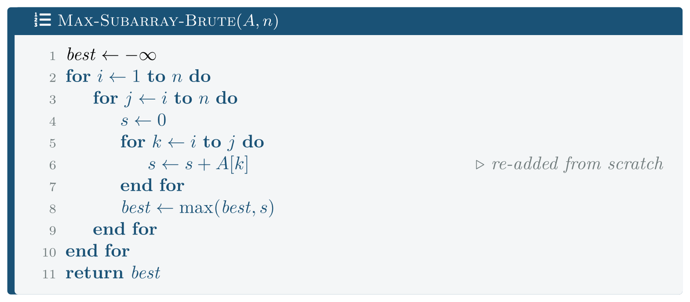
Max-Subarray-Brute: every block, summed from scratch
FIGURE 7.1
Three nested loops, so Θ(n3) — and lines 4 to 7 are doing work that lines 4 to 7 of the previous iteration already did.
Analysis of Algorithms · Chapter 7 · Brute Force, and When It Is the Right Answer
§7.2 · Handout p. 57 11
Notes:
Figure 7.1 (handout p. 57): Max-Subarray-Brute: every block, summed from scratch. Three nested loops, so Θ(n3) — and lines 4 to 7 are doing work that lines 4 to 7 of the previous iteration already did.

Slide 12

The brute force is cubic
THEOREM 7.1
Max-Subarray-Brute runs in Θ(n³) time.
Analysis of Algorithms · Chapter 7 · Brute Force, and When It Is the Right Answer
§7.2 · Handout p. 57 12
Notes:
Proof. For each pair (i,j) with i ≤ j, the inner loop performs j − i + 1 additions. Summing over all pairs, Σᵢ₌₁ⁿΣⱼ₌ᵢⁿ (j−i+1) = Σᵢ₌₁ⁿΣₘ₌₁ⁿ−ⁱ⁺¹ m = Σᵢ₌₁ⁿ ((n−i+1)(n−i+2))/2 = Σₚ₌₁ⁿ (p(p+1))/2. The last sum is /12(Σ p² + Σ p) = /12((n(n+1)(2n+1))/6 + (n(n+1))/2), whose leading term is n³/6. By Lemma 3.2 this is Θ(n³). Every other operation is O(1) per pair, contributing O(n²), which the sum rule absorbs.

Slide 13
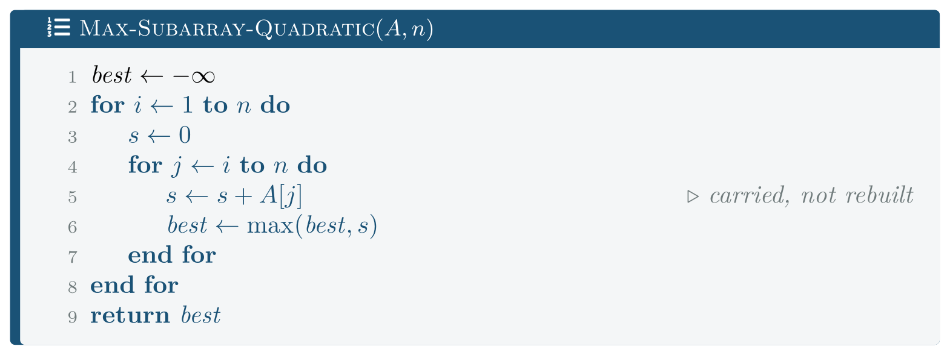
Max-Subarray-Quadratic
FIGURE 7.2
The search is unchanged — still every pair (i,j) — but each candidate now costs O(1) instead of O(n). A better accountant, not a better idea.
Analysis of Algorithms · Chapter 7 · Brute Force, and When It Is the Right Answer
§7.2 · Handout p. 57 13
Notes:
The inner loop recomputes a sum the previous iteration almost had. Extending the block from j to j+1 costs one addition.
Figure 7.2 (handout p. 58): Max-Subarray-Quadratic. The search is unchanged — still every pair (i,j) — but each candidate now costs O(1) instead of O(n). A better accountant, not a better idea.

Slide 14

This is the distinction the chapter exists for
WATCH OUT
Going from n² to n, next, will change the search itself — it will stop examining pairs at all.
Both are worth doing and they are different activities. The first is careful programming and gets you a constant or a factor of n; the second requires an idea about the problem, and it is what the rest of this book is about.
Analysis of Algorithms · Chapter 7 · Brute Force, and When It Is the Right Answer
§7.2 · Handout p. 57 14
Notes:
Read the box aloud, then ask for an example from the room before moving on.

Slide 15
An Idea About the Problem
SECTION 3 OF 5
7.3
7.1 The Strategy With No Ideas In It
7.2 A Problem With Three Answers
7.3 An Idea About the Problem
7.4 The Three, Raced
7.5 When Brute Force Is the Right Answer
Analysis of Algorithms · Chapter 7
Handout §7.3 15
Notes:
Pause. Name the question this section answers.

Slide 16
Kadane’s observation
CONCEPT
Ask a smaller question: what is the best block ending exactly at position j?
Such a block either extends the best block ending at j−1, or it starts fresh at j. There is no third option — a block ending at j that does not contain j−1 must begin at j. So if H_{j} is the best sum ending at j,
and the answer is max_{j} H_{j}.
That one sentence removes an entire dimension from the search. It is also the first appearance in this book of optimal substructure — the best solution built from best solutions to smaller versions — which Chapter 15 makes into a general technique.
Analysis of Algorithms · Chapter 7 · Brute Force, and When It Is the Right Answer
§7.3 · Handout p. 58 16
Notes:
Read the box aloud, then ask for an example from the room before moving on.

Slide 17
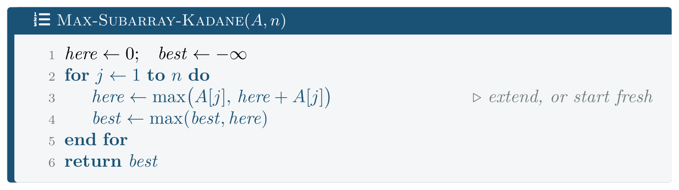
Max-Subarray-Kadane
FIGURE 7.3
One pass, two variables. The loop invariant is what makes it believable, and Theorem 7.2 is what makes it true.
Analysis of Algorithms · Chapter 7 · Brute Force, and When It Is the Right Answer
§7.3 · Handout p. 58 17
Notes:
Figure 7.3 (handout p. 58): Max-Subarray-Kadane. One pass, two variables. The loop invariant is what makes it believable, and Theorem 7.2 is what makes it true.

Slide 18
Kadane’s algorithm is correct
THEOREM 7.2
Max-Subarray-Kadane returns the maximum subarray sum, in Θ(n) time.
Analysis of Algorithms · Chapter 7 · Brute Force, and When It Is the Right Answer
§7.3 · Handout p. 58 18
Notes:
Proof. Invariant: at the start of the iteration for j, here is the maximum sum of a block ending at j−1, and best is the maximum sum of any block within A[1 j−1]. Initialisation. Before j = 1 both ranges are empty; best = −∞ correctly records that no block has been seen, and here = 0 is the empty sum. Maintenance. Assume the invariant before iteration j. Any block ending at j either contains j−1 — in which case its sum is (the sum of a block ending at j−1) + A[j], maximised by here + A[j] using the invariant — or it does not, in which case it is A[j] alone. Line 3 takes the larger of exactly these two, so afterwards here is the best sum ending at j. Line 4 then extends the running maximum over one more position, re-establishing the invariant for j+1. Termination. The loop runs n times and stops. Substituting j = n+1 into the invariant, best is the maximum sum of any block within A[1n], which is the postcondition. The body is O(1) and runs n times, so the time is Θ(n).

Slide 19
The Three, Raced
SECTION 4 OF 5
7.4
7.1 The Strategy With No Ideas In It
7.2 A Problem With Three Answers
7.3 An Idea About the Problem
7.4 The Three, Raced
7.5 When Brute Force Is the Right Answer
Analysis of Algorithms · Chapter 7
Handout §7.4 19
Notes:
Pause. Name the question this section answers.

Slide 20

First, Do They Agree?
WORKED EXAMPLE
A faster algorithm that returns a different answer is not faster. Before any timing, code/ch07_brute.cpp runs all three on the same inputs:
n | cubic | quadratic | linear
1 | 35 | 35 | 35 | agree
2 | 80 | 80 | 80 | agree
10 | 265 | 265 | 265 | agree
100 | 563 | 563 | 563 | agree
500 | 1362 | 1362 | 1362 | agree
This is the oracle use of brute force, and it is not a formality. The cubic version is three nested loops with no ideas in it and is almost impossible to get wrong; Kadane’s is four lines that are easy to get subtly wrong — initialise best to 0 instead of −∞ and it silently returns 0 for an all-negative array. The agreement above is evidence, cheaply bought.
Analysis of Algorithms · Chapter 7 · Brute Force, and When It Is the Right Answer
§7.4 · Handout p. 59 20
Notes:
Each click adds one step of the working. Ask for the next number before you reveal it.

Slide 21
The Predicted Ratios: 8, 4, 2
WORKED EXAMPLE
Doubling n should multiply a cubic time by 8, a quadratic by 4 and a linear by 2. Median of 3, 15 and 101 runs respectively; times in milliseconds.
n | cubic | ratio | quadratic | ratio | linear | ratio
500 | 7.66 | — | 0.070 | — | 0.0005 | —
1,000 | 60.25 | 7.86 | 0.304 | 4.32 | 0.0010 | 2.00
2,000 | 471.16 | 7.82 | 1.095 | 3.60 | 0.0018 | 1.80
4,000 | 3355.85 | 7.12 | 4.348 | 3.97 | 0.0035 | 1.94
8,000 | — | — | 17.299 | 3.98 | 0.0071 | 2.03
Means: 7.60, 3.97, 1.94 against predicted 8, 4, 2.
Analysis of Algorithms · Chapter 7 · Brute Force, and When It Is the Right Answer
§7.4 · Handout p. 59 21
Notes:
Each click adds one step of the working. Ask for the next number before you reveal it.

Slide 22
The Predicted Ratios: 8, 4, 2 (continued)
WORKED EXAMPLE
Now read the first and last columns together. At n = 4,000 the cubic version takes 3.36 seconds and the linear version takes 3.5 microseconds — a factor of about a million. At n = 500 the factor was about fifteen thousand. The gap is not a constant; it grows as n², which is exactly what “Θ(n³) against Θ(n)” means in seconds.
And the row that is missing — cubic at n = 8,000 — is missing because it would take about 27 seconds for a result the linear version produces in 7 microseconds.
Analysis of Algorithms · Chapter 7 · Brute Force, and When It Is the Right Answer
§7.4 · Handout p. 59 22
Notes:
Each click adds one step of the working. Ask for the next number before you reveal it.

Slide 23
When Brute Force Is the Right Answer
SECTION 5 OF 5
7.5
7.1 The Strategy With No Ideas In It
7.2 A Problem With Three Answers
7.3 An Idea About the Problem
7.4 The Three, Raced
7.5 When Brute Force Is the Right Answer
Analysis of Algorithms · Chapter 7
Handout §7.5 23
Notes:
Pause. Name the question this section answers.

Slide 24
What It Costs, in Absolute Terms
WORKED EXAMPLE
The same cubic routine, read as a cost rather than as a ratio:
n | cubic | verdict
10 | 0.1 μs | imperceptible
30 | 2.1 μs | imperceptible
100 | 78.8 μs | imperceptible
300 | 1.6 ms | a visible pause
1,000 | 52.3 ms | a visible pause
3,000 | 1470.1 ms | too slow to ship
Analysis of Algorithms · Chapter 7 · Brute Force, and When It Is the Right Answer
§7.5 · Handout p. 60 24
Notes:
The table above makes brute force look indefensible. In absolute terms it often is not.
Each click adds one step of the working. Ask for the next number before you reveal it.

Slide 25
What It Costs, in Absolute Terms (continued)
WORKED EXAMPLE
At n = 100 the cubic algorithm takes 79 microseconds. If your arrays are bounded by a hundred elements and the routine runs once per user action, the asymptotically terrible algorithm is the correct engineering choice: it is four lines, it needs no proof, and nobody will ever notice.
The decision turns on the range of n, not on the exponent. Which is why the first question to ask about any algorithm is not “what is its order of growth” but “how big does n get”.
Analysis of Algorithms · Chapter 7 · Brute Force, and When It Is the Right Answer
§7.5 · Handout p. 60 25
Notes:
Each click adds one step of the working. Ask for the next number before you reveal it.

Slide 26
A checklist
CONCEPT
Brute force is defensible when all of these hold:
• n is small and bounded by something real — a board size, a number of columns, a field count — not merely small today;
• the code runs rarely, or off the critical path;
• correctness matters more than speed, and the short version is the one you can convince yourself of;
• you have measured, at the largest n you will actually see.
It is indefensible when n is unbounded or user-supplied, because then you have not chosen a slow algorithm, you have chosen an unbounded one — and Chapter 22 is about problems where that is the only choice anyone knows.
Analysis of Algorithms · Chapter 7 · Brute Force, and When It Is the Right Answer
§7.5 · Handout p. 60 26
Notes:
Read the box aloud, then ask for an example from the room before moving on.

Slide 27

Common pitfalls
COMMON PITFALLS
✕
Confusing “removed redundant work” with “found a better algorithm”. The cubic-to-quadratic step did not change which candidates were examined. The quadratic-to-linear step did.
✕
Initialising best to 0 in Kadane’s algorithm. It then returns 0 on an all-negative array, which is wrong unless the empty block is allowed — and if it is, say so in the specification.
✕
Dismissing brute force without measuring. 79 microseconds at n = 100 is not a performance problem.
✕
Keeping brute force when n is user-supplied. “Small in practice” is a prediction, and users falsify it.
✕
Not writing the brute force at all. You then have nothing to test the clever version against, which is how subtly wrong algorithms reach production.
✕
Timing the brute force once and the clever one once. At microsecond scale one run measures the scheduler.
Analysis of Algorithms · Chapter 7 · Brute Force, and When It Is the Right Answer
§7.5 · Handout p. 60 27
Notes:
For each pitfall, ask who has seen it happen. One real story beats five bullets.

Slide 28

Try it yourself: Three Algorithms, One Problem
TRY IT YOURSELF
Reproduces all three tables. Expect twenty-five minutes; the cubic column at n = 4,000 takes about ten seconds on its own.
WHAT YOU WILL DO
1. Brute force, as literally as it can be written
2. The same search, with the waste removed
3. Kadane: a different idea, not a faster loop
4. All three agree, which is what makes the race fair
5. The ratios each order of growth predicts
6. Where brute force is the right answer
THIS WEEK'S LAB
WHAT YOU WILL RUN
RUNNABLE COPY
Week 5: Where n2 beats n lg n, and by how much
1 listing, 59 lines of C++
code/ch07_brute.cpp
Analysis of Algorithms · Chapter 7 · Brute Force, and When It Is the Right Answer
§7.5 · Handout p. 60 28
Notes:
Reproduces all three tables. Expect twenty-five minutes; the cubic column at n = 4,000 takes about ten seconds on its own.

Slide 29
Three Algorithms, One Problem
LAB · STEP 1 OF 6
Brute force, as literally as it can be written
C++ · code/ch07_brute.cpp
1
2
3
4
5
6
7
8
9
10
11
12
13
14
15
16
17
// ch07_brute.cpp -- brute force, and the two things that beat it.
// Build: cl /O2 /EHsc /std:c++17 ch07_brute.cpp (see Appendix A)
// --- 1. Brute force, as literally as it can be written -------------
// For every start i and end j, add up a[i..j] from scratch. The inner
// re-addition is pure waste, and it is the n^3.
static long long max_sub_cubic(const std::vector<int>& a) {
long long best = std::numeric_limits<long long>::min();
size_t n = a.size();
for (size_t i = 0; i < n; ++i)
for (size_t j = i; j < n; ++j) {
long long s = 0;
for (size_t k = i; k <= j; ++k) s += a[k];
best = std::max(best, s);
}
return best;
}
Analysis of Algorithms · Chapter 7 · Brute Force, and When It Is the Right Answer
§7.5 · Handout p. 60 29
Notes:
Step 1: Brute force, as literally as it can be written. Read the code aloud; ask what each line would print before running it.

Slide 30
Three Algorithms, One Problem
LAB · STEP 2 OF 6
The same search, with the waste removed
C++ · code/ch07_brute.cpp
19
20
21
22
23
24
25
26
27
28
29
30
31
32
33
34
// --- 2. The same search, with the waste removed --------------------
// Extending the block from j to j+1 costs one addition, not a fresh
// traversal. The SEARCH is unchanged -- still every (i, j) pair -- so
// this is not yet a better idea, only a better accountant.
static long long max_sub_quadratic(const std::vector<int>& a) {
long long best = std::numeric_limits<long long>::min();
size_t n = a.size();
for (size_t i = 0; i < n; ++i) {
long long s = 0;
for (size_t j = i; j < n; ++j) {
s += a[j];
best = std::max(best, s);
}
}
return best;
}
Analysis of Algorithms · Chapter 7 · Brute Force, and When It Is the Right Answer
§7.5 · Handout p. 60 30
Notes:
Step 2: The same search, with the waste removed. Read the code aloud; ask what each line would print before running it.

Slide 31
Three Algorithms, One Problem
LAB · STEP 3 OF 6
Kadane: a different idea, not a faster loop
C++ · code/ch07_brute.cpp
36
37
38
39
40
41
42
43
44
45
46
47
48
// --- 3. Kadane: a different idea, not a faster loop ----------------
// Invariant: after processing a[0..j], "here" is the largest sum of a
// block ENDING at j, and "best" the largest sum anywhere in a[0..j].
// A block ending at j+1 either extends the best block ending at j, or
// starts fresh. That one observation removes a whole dimension.
static long long max_sub_linear(const std::vector<int>& a) {
long long best = std::numeric_limits<long long>::min(), here = 0;
for (int x : a) {
here = std::max((long long)x, here + x);
best = std::max(best, here);
}
return best;
}
Analysis of Algorithms · Chapter 7 · Brute Force, and When It Is the Right Answer
§7.5 · Handout p. 60 31
Notes:
Step 3: Kadane: a different idea, not a faster loop. Read the code aloud; ask what each line would print before running it.

Slide 32
Three Algorithms, One Problem
LAB · STEP 4 OF 6
All three agree, which is what makes the race fair
C++ · code/ch07_brute.cpp
50
51
// --- 4. All three agree, which is what makes the race fair ---------
// A faster algorithm that gets a different answer is not faster.
Analysis of Algorithms · Chapter 7 · Brute Force, and When It Is the Right Answer
§7.5 · Handout p. 60 32
Notes:
Step 4: All three agree, which is what makes the race fair. Read the code aloud; ask what each line would print before running it.

Slide 33
Three Algorithms, One Problem
LAB · STEP 5 OF 6
The ratios each order of growth predicts
C++ · code/ch07_brute.cpp
53
54
// --- 5. The ratios each order of growth predicts -------------------
// Doubling n should multiply the times by 8, 4 and 2.
Analysis of Algorithms · Chapter 7 · Brute Force, and When It Is the Right Answer
§7.5 · Handout p. 60 33
Notes:
Step 5: The ratios each order of growth predicts. Read the code aloud; ask what each line would print before running it.

Slide 34
Three Algorithms, One Problem
LAB · STEP 6 OF 6
Where brute force is the right answer
C++ · code/ch07_brute.cpp
56
57
58
59
// --- 6. Where brute force is the right answer ----------------------
// Report the ABSOLUTE cost, not a ratio against a linear time too
// small to measure, and say where it crosses thresholds a person
// would actually notice.
Analysis of Algorithms · Chapter 7 · Brute Force, and When It Is the Right Answer
§7.5 · Handout p. 60 34
Notes:
Step 6: Where brute force is the right answer. Read the code aloud; ask what each line would print before running it.

Slide 35
What the lab shows
TRY IT YOURSELF
What to notice. Part A costs almost nothing to run and is the most valuable part of the program. Delete it and the other two parts are a race between three functions you have not checked.
Then try to break it. Change best in max_sub_linear from numeric_limits::min() to 0, and run part A again. Every row still agrees — because the random inputs all contain a positive block. Now generate an all-negative array and watch part A catch it. An oracle only tests the inputs you give it, which is Chapter 2’s point about distributions arriving again in a new costume.
Analysis of Algorithms · Chapter 7 · Brute Force, and When It Is the Right Answer
§7.5 · Handout p. 60 35
Notes:
Read the box aloud, then ask for an example from the room before moving on.

Slide 36

The cubic algorithm performs Σ_{i}Σ_{j≥ i}(j−i+1) additions. Evaluate this sum for n = 100 and check it against n³/6.
CHECKPOINT 1 OF 3
Discuss with the person next to you, then advance.
Analysis of Algorithms · Chapter 7 · Brute Force, and When It Is the Right Answer
Handout p. 63 · answers in Appendix D 36
Notes:
Ask the room. Do not advance until someone commits to an answer.

Slide 37

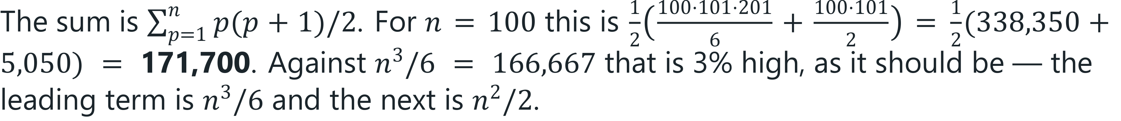
The cubic algorithm performs Σ_{i}Σ_{j≥ i}(j−i+1) additions. Evaluate this sum for n = 100 and check it against n³/6.
CHECKPOINT 1 OF 3 · ANSWER
Analysis of Algorithms · Chapter 7 · Brute Force, and When It Is the Right Answer
Handout p. 63 · answers in Appendix D 37
Notes:
Answer (Appendix D): The sum is Σp=1n p(p+1)/2. For n = 100 this is /12((100·101·201)/6 + (100·101)/2) = /12(338,350 + 5,050) = 171,700. Against n3/6 = 166,667 that is 3% high, as it should be — the leading term is n3/6 and the next is n2/2.

Slide 38
Explain why going from n³ to n² did not require any insight into the maximum-subarray problem, while going from n² to n did.
CHECKPOINT 2 OF 3
Discuss with the person next to you, then advance.
Analysis of Algorithms · Chapter 7 · Brute Force, and When It Is the Right Answer
Handout p. 63 · answers in Appendix D 38
Notes:
Ask the room. Do not advance until someone commits to an answer.

Slide 39
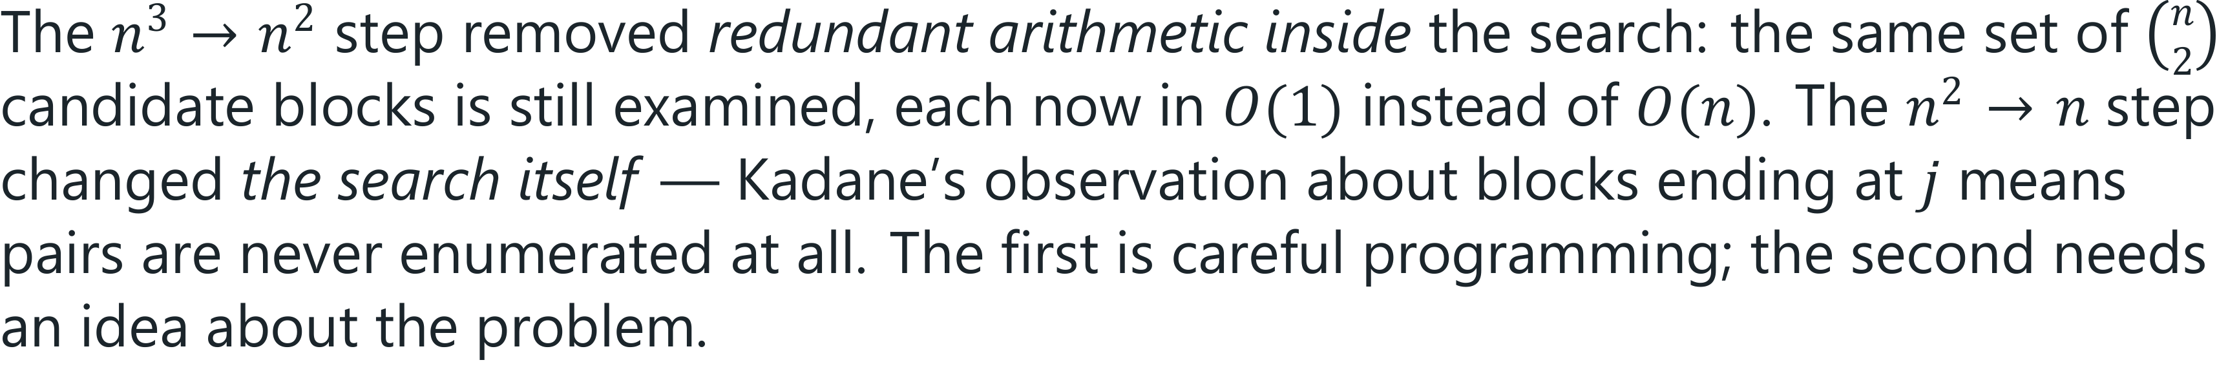
Explain why going from n³ to n² did not require any insight into the maximum-subarray problem, while going from n² to n did.
CHECKPOINT 2 OF 3 · ANSWER
Analysis of Algorithms · Chapter 7 · Brute Force, and When It Is the Right Answer
Handout p. 63 · answers in Appendix D 39
Notes:
Answer (Appendix D): The n3 → n2 step removed redundant arithmetic inside the search: the same set of n2 candidate blocks is still examined, each now in O(1) instead of O(n). The n2 → n step changed the search itself — Kadane’s observation about blocks ending at j means pairs are never enumerated at all. The first is careful programming; the second needs an idea about the problem.

Slide 40
Give a concrete situation in which you would ship the Θ(n³) version, and state the one fact that would change your mind.
CHECKPOINT 3 OF 3
Discuss with the person next to you, then advance.
Analysis of Algorithms · Chapter 7 · Brute Force, and When It Is the Right Answer
Handout p. 63 · answers in Appendix D 40
Notes:
Ask the room. Do not advance until someone commits to an answer.

Slide 41
Give a concrete situation in which you would ship the Θ(n³) version, and state the one fact that would change your mind.
CHECKPOINT 3 OF 3 · ANSWER
Ship the cubic version when n is bounded by something real and small — a board of at most 64 squares, a form with at most 50 fields — and the routine is off the critical path. Measured, it costs 79 μs at n = 100. The fact that would change my mind: that n is user-supplied or unbounded, because then the bound is a prediction rather than a fact.
Analysis of Algorithms · Chapter 7 · Brute Force, and When It Is the Right Answer
Handout p. 63 · answers in Appendix D 41
Notes:
Answer (Appendix D): Ship the cubic version when n is bounded by something real and small — a board of at most 64 squares, a form with at most 50 fields — and the routine is off the critical path. Measured, it costs 79 μs at n = 100. The fact that would change my mind: that n is user-supplied or unbounded, because then the bound is a prediction rather than a fact.

Slide 42

What to take away
CHAPTER SUMMARY
1
Brute force generates every candidate and tests it. It needs no insight into the problem, which is both its weakness and its value.
2
It earns its place as the baseline to improve on and the oracle to test against — and sometimes as the answer.
3
Maximum subarray has three solutions: Θ(n³) exhaustive, Θ(n²) with the redundant re-summation removed, and Θ(n) by Kadane’s observation.
4
Removing redundant work within a search is different from changing the search. Only the second needs an idea about the problem, and it is the one this book is mostly about.
5
Measured ratios on doubling: 7.60, 3.97, 1.94 against predicted 8, 4, 2. At n = 4,000 the cubic version took 3.4 seconds and the linear one 3.5 microseconds.
6
Measured absolutely, the cubic version costs 79 μs at n = 100 and 1.5 s at n = 3,000. For a bounded small n it is the right choice.
Analysis of Algorithms · Chapter 7 · Brute Force, and When It Is the Right Answer
Handout p. 63 42
Notes:
Ask the room to say each takeaway before you reveal it.

Slide 43
What to take away (continued)
CHAPTER SUMMARY
7
The first question about an algorithm is how big n gets, not what its exponent is.
Analysis of Algorithms · Chapter 7 · Brute Force, and When It Is the Right Answer
Handout p. 63 43
Notes:
Ask the room to say each takeaway before you reveal it.

Slide 44

Quick check 1 of 2
REVIEW · MULTIPLE CHOICE
The brute-force maximum-subarray algorithm runs in:
A
Θ(n)
B
Θ(n lg n)
C
Θ(n²)
D
Θ(n³)
Analysis of Algorithms · Chapter 7 · Brute Force, and When It Is the Right Answer
Handout p. 63 44
Notes:
Take a show of hands for each option before discussing. (The handout does not print MCQ answers.)

Slide 45
Quick check 2 of 2
REVIEW · MULTIPLE CHOICE
Kadane’s algorithm improves on the quadratic version by:
A
using a faster inner loop
B
examining fewer candidate blocks
C
using recursion
D
sorting the input first
Analysis of Algorithms · Chapter 7 · Brute Force, and When It Is the Right Answer
Handout p. 63 45
Notes:
Take a show of hands for each option before discussing. (The handout does not print MCQ answers.)

Slide 46
For your notebook
REVIEW QUESTIONS
SHORT
Define the brute-force strategy and give two reasons a course on algorithm design includes it (CLO-6).
SHORT
State Kadane’s loop invariant and explain why only two cases need be considered in its maintenance step.
SHORT
Explain the oracle use of a brute-force implementation, and its one limitation.
APPLIED
Give a brute-force algorithm for finding the closest pair among n points in the plane, state its running time with justification, and say what you would need to beat it.
APPLIED
Your team has a Θ(n³) routine running on n ≤ 80, taking about 40 μs. A colleague proposes replacing it with a Θ(n) version, 60 lines long. Argue both sides, and state the single piece of information that should decide it.
Analysis of Algorithms · Chapter 7 · Brute Force, and When It Is the Right Answer
Handout p. 63 46
Notes:
Set these for independent study. Model answers are not printed in the handout.

Slide 47
End of Chapter 7
07
NEXT
READ
Chapter 8 — Divide and Conquer: Merge Sort and the Pattern
Handout Chapter 7, pages 56–63
THIS WEEK'S LAB
Where n2 beats n lg n, and by how much
Analysis of Algorithms · Chapter 7 · Brute Force, and When It Is the Right Answer
47
Notes:
Close. NEXT: Chapter 8 — Divide and Conquer: Merge Sort and the Pattern. READ: Handout Chapter 7, pages 56–63. THIS WEEK'S LAB: Where n2 beats n lg n, and by how much.

